Slide 1

Let’s start with Allah Yaar
Bs in Computer Science

Slide 2
Differences Between the Internet, an Intranet, and an Extranet
Theory:
Internet: A global network enabling access to public information and services. It uses open standards and protocols (e.g., HTTP, TCP/IP).
Intranet: A private network within an organization, designed for internal communication and resource sharing. Access is restricted to authorized users.
Extranet: Extends the intranet to external stakeholders (e.g., partners, suppliers) via controlled access.

Slide 3
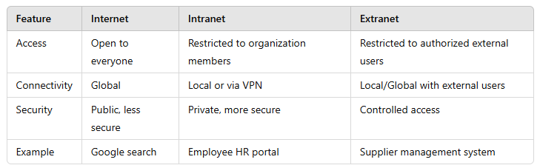
Differences Between the Internet, an Intranet, and an Extranet

Slide 4
Differences Between the Internet, an Intranet, and an Extranet
Practical Insights:
VPN (Virtual Private Network) is often used to securely connect to intranets.
Extranets improve collaboration between businesses but require strong access controls.
Example:
Internet: Public websites like Wikipedia.
Intranet: A company’s document-sharing system for internal employees.
Extranet: A retailer shares inventory details with suppliers through a secured portal.

Slide 5
Differences Between the Internet, an Intranet, and an Extranet
Visual Aid:
Illustrate a network with:
Public users accessing the Internet.
Employees connected to an intranet.
Partners accessing an extranet via secure gateways.

Slide 6
Blog, Forum, Wiki, Social Networking
Theory:
Blog: An online journal or informational website showcasing posts in reverse chronological order. Blogs are often personal or thematic.
Forum: A digital platform where users discuss topics, share knowledge, and post queries.
Wiki: A collaborative platform where users create, edit, and manage content, often used for documentation or knowledge sharing.
Social Networking: Platforms allowing users to connect, share content, and interact (e.g., Facebook, LinkedIn).

Slide 7
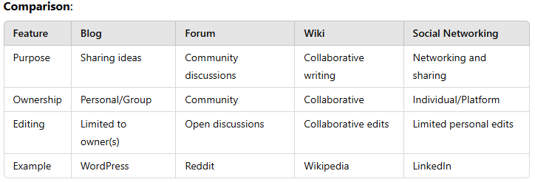
Blog, Forum, Wiki, Social Networking

Slide 8
Blog, Forum, Wiki, Social Networking
Practical Insights:
Social Networking tools like LinkedIn are essential for professional connections.
Blogs are used by businesses for content marketing, while forums facilitate customer support.
Examples:
Blog: A cooking blog sharing recipes.
Forum: A tech discussion board like Stack Overflow.
Wiki: Wikipedia entries collaboratively edited by users.
Social Networking: Twitter threads on industry trends.

Slide 9
ISP, HTTP, HTTPS, FTP, SSL
ISP (Internet Service Provider)
Definition: Organizations that provide access to the Internet.
Responsibilities: Allocate IP addresses, manage bandwidth, and ensure connectivity.
Examples: Comcast, Airtel, Vodafone.

Slide 10
ISP, HTTP, HTTPS, FTP, SSL
HTTP (Hypertext Transfer Protocol)
Definition: Protocol for transferring web pages over the Internet.
Features: Stateless, uses port 80, enables browsing.
Limitations: Data is transferred in plain text, making it insecure.

Slide 11
ISP, HTTP, HTTPS, FTP, SSL
HTTPS (HTTP Secure)
Definition: Secure version of HTTP using encryption via SSL/TLS.
Features: Ensures data confidentiality and integrity. Uses port 443.
Applications: Online banking, e-commerce.
Example: Accessing a secure site like https://amazon.com

Slide 12
ISP, HTTP, HTTPS, FTP, SSL
FTP (File Transfer Protocol)
Definition: Protocol for transferring files between systems over the Internet.
Features: Uses ports 20/21. Can be anonymous or authenticated.
Example: Uploading a website to a hosting server via FTP client (e.g., FileZilla).

Slide 13
ISP, HTTP, HTTPS, FTP, SSL
SSL (Secure Sockets Layer)
Definition: A cryptographic protocol securing data transferred over a network.
Applications: HTTPS, VPNs, email security.
Example: SSL certificates displayed as a lock icon in web browsers.

Slide 14
ISP, HTTP, HTTPS, FTP, SSL
Practical Insights:
ISPs monitor traffic and may enforce data caps.
SSL/TLS ensures encrypted communication for sensitive data like passwords or credit card details.
FTP is gradually being replaced by secure alternatives like SFTP (Secure FTP).

Slide 15
ISP, HTTP, HTTPS, FTP, SSL
Examples:
ISP: A student subscribes to an ISP for a fiber-optic Internet connection.
HTTP/HTTPS: Viewing a Wikipedia page (http://) then switching to secure login (https://)
FTP: Uploading project files to a university server.
SSL: A banking website showing a secure connection with a green padlock icon.

Slide 16
ISP, HTTP, HTTPS, FTP, SSL
Visual Aid:
Illustrate protocols in use:
HTTP vs. HTTPS with encryption.
ISP providing Internet to home networks.

Slide 17
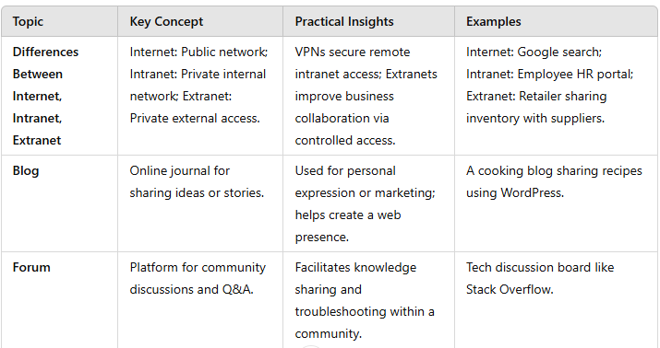
Summary Table

Slide 18
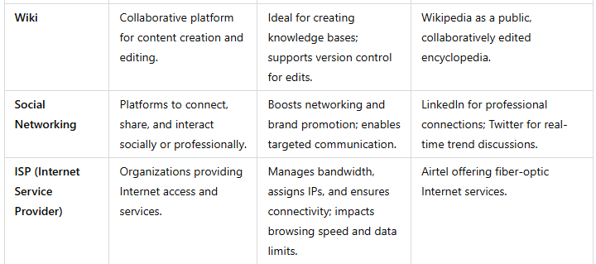
Summary Table

Slide 19
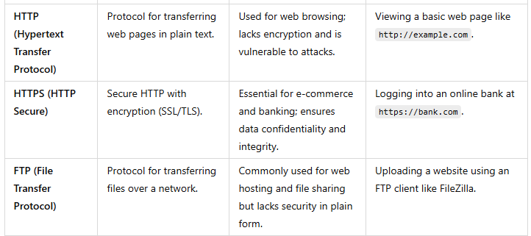
Summary Table

Slide 20
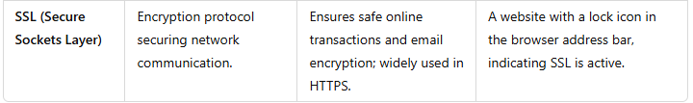
Summary Table

